Slide 1

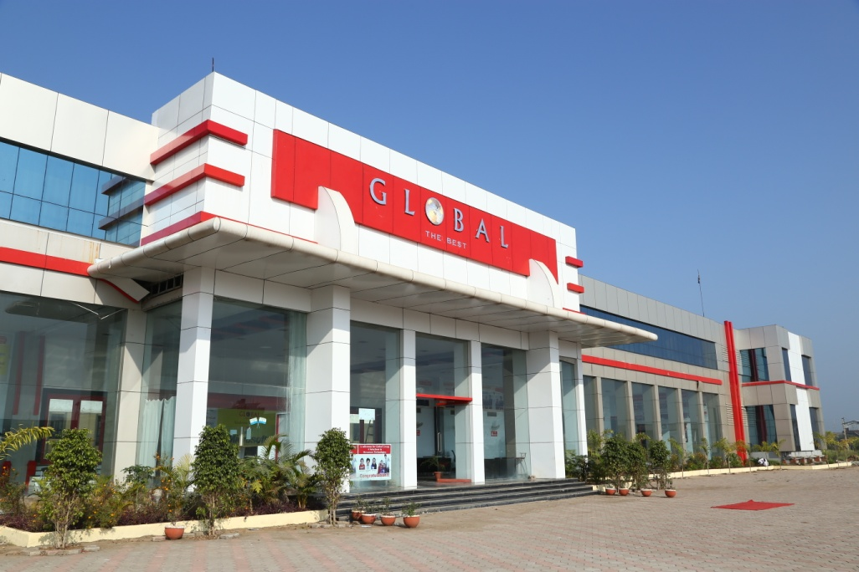
This Project is submitted to Rajiv Gandhi Proudyogiki Vishwavidyalaya, Bhopal, Madhya Pradesh
E-Commerce Website Using MERN Stack
Submitted By :
Atul Chourasia 0225IT191017
Shreyash Tamrakar 0225IT191056
Devansh Nema 0225IT191026
Amit Singh 0225IT191008
Global Nature Care Sangathan’s Group Of Institutes , Jabalpur
Submitted To :
Prof. Abhishek Singh Sir

Slide 2

Table Of Contents
Introduction
Technology Used
Software And Tools Used
Work Flow
Application Structure
Some Snaps of Project
Future Implementations
Conclusion

Slide 3
Introduction
What Is E-Commerce?
Classification Of E-Commerce
E-Commerce is the process of buying and selling products through the internet, and also the transfer of money and the data to complete the process of buying or selling a product
There are mainly four types of E-commerce business models
B2B (eg. fotolia.com)
B2C (eg. Amazon,Myntra)
C2C (eg. OLX.com)
C2B (eg. Naukri.com)

Slide 4
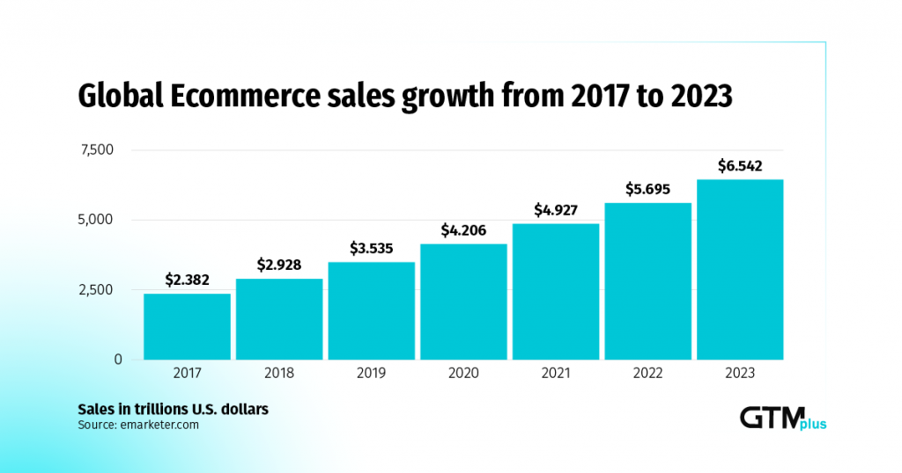
Why E-Commerce?

Slide 5
Modules
Previously Implemented
Newly Implemented
Home Page
SignUp/Signin
Admin Dashboard
Product Managment
Payment Gateway
New and better UI
Encrypted password
Added Cart
Category Listing of product.

Slide 6
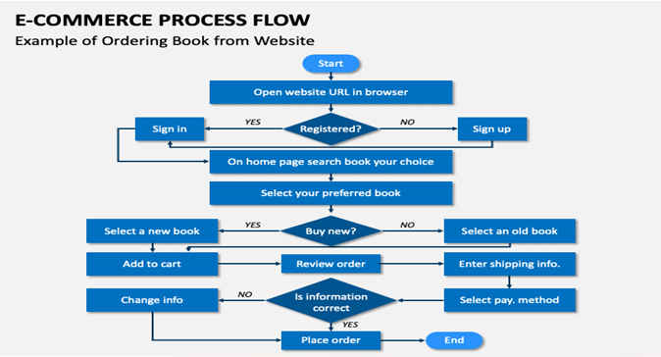

Slide 7
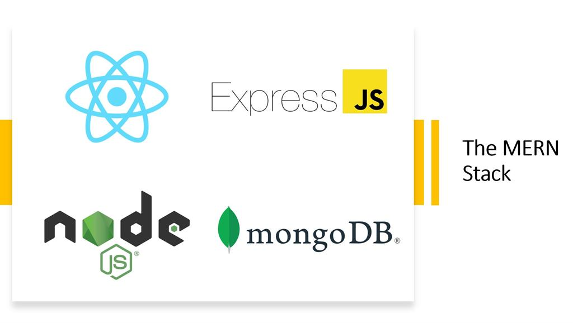
Technology Used

Slide 8

MongoDB: It is an open cross-platform program. It comes
under the NoSQL database
classification. It was a document
oriented database. It uses JSON
format documents with optional
Schemas
Data Flexibility available means Large data can be distributed into several connected Files.
High speed of fetching of data
possible because it only depends on
indexing.
Horizontally scalable
database so it can handle the data
make us easy to distribute to serval
machines.

Slide 9

It is a famous Library of
node.js used for routing. It has some
methods like a router which help to
do curd operations like put, get, post,and delete request .
Robust routing
It will focus on high performance
*It is an HTTP helper like it will help with redirection, catching, editing etc.

Slide 10

React is a library of javascript which is created by Facebook. React is mainly used as a UI which means Maximum it is used for client-side applications. There are so
many libraries like React gh side Library in React-dom, Reactrouter-dom, and many more to help to build the frontend of any
application.
* The rendering of the page will be
much faster than others because it
has virtual Dom.
*uses a stable code.
* It has a strong community
followed.

Slide 11
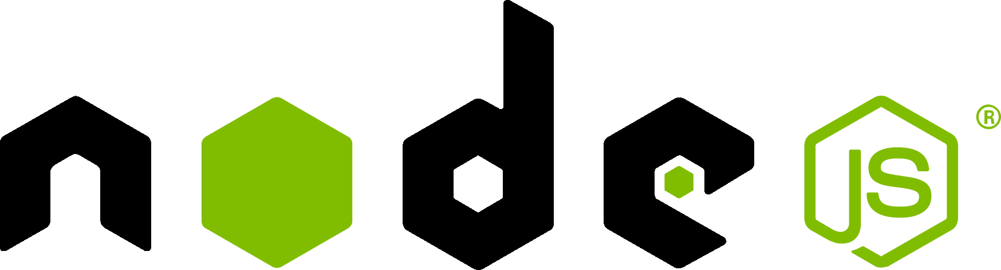
*NodeJS is open source and it is free of cost.
*NodeJS uses asynchronous
programming by default.
* NodeJS will always store the data in only
JSON format.
NodeJS is a runtime
javascript environment that works
outside the web page. It is mainly
used for server-side applications.

Slide 12
Software And Tools Used
VS Code Editor
Postman
Figma
MongoDB Compass
Robo3T

Slide 13
Some Snaps of Project Development
COSTUMERS/Normal users
Admin/Producer
Can create user/costumer accounts with emails (Homepage)
Signin, Signup ,Signout
User Dashdoard for every user.
Product Gallery/Display in Home page.
Separate Cart for Every user.
Payment Gateway.
Admin Dashbord
Can Create Different Products
manage & delete products
Create Separate Categories
Can also perfom all activities available to normal users

Slide 14
Work-Flow
Step
By
Step

Slide 15
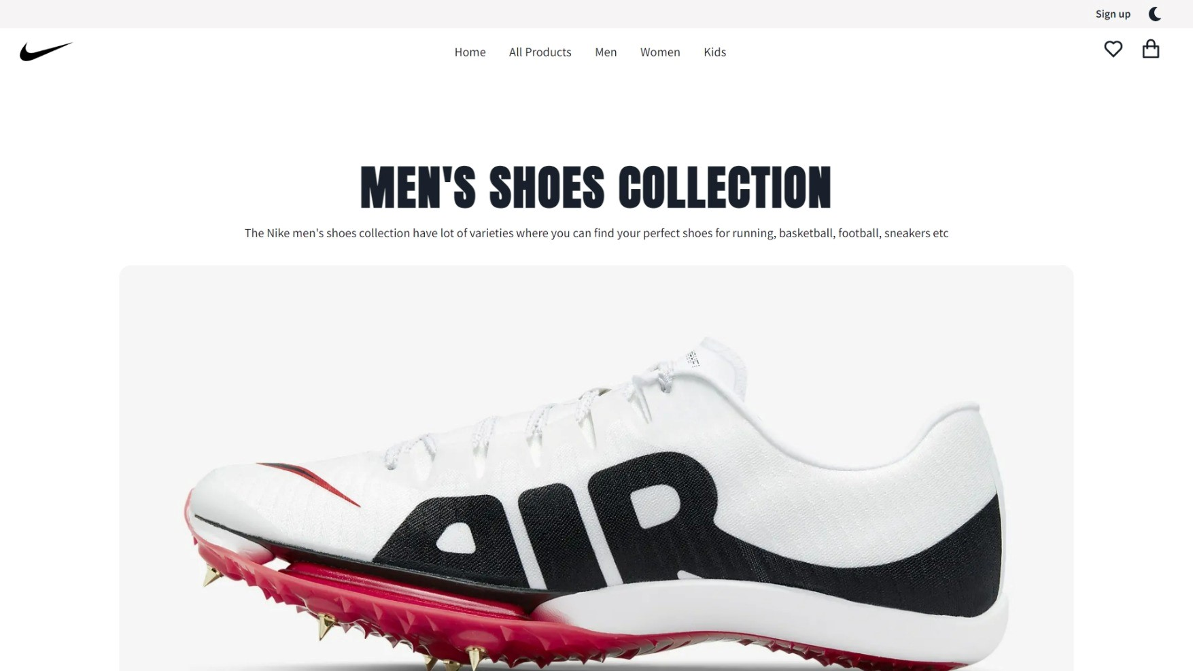

Slide 16
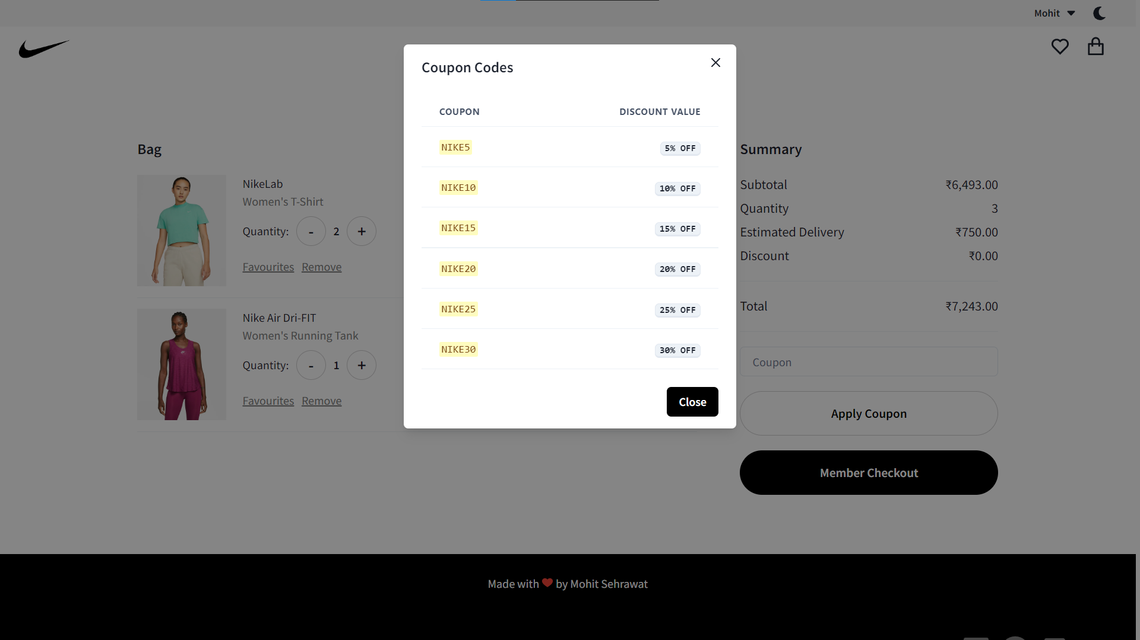

Slide 17
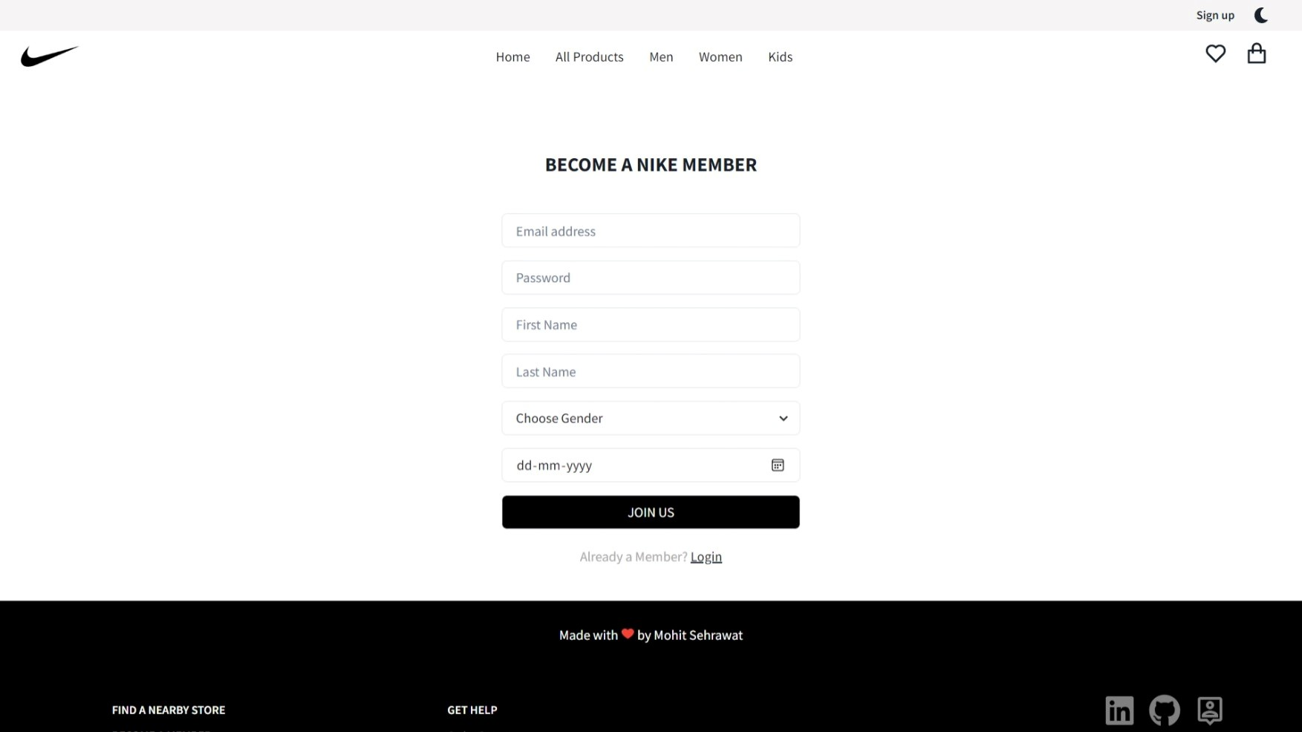

Slide 18
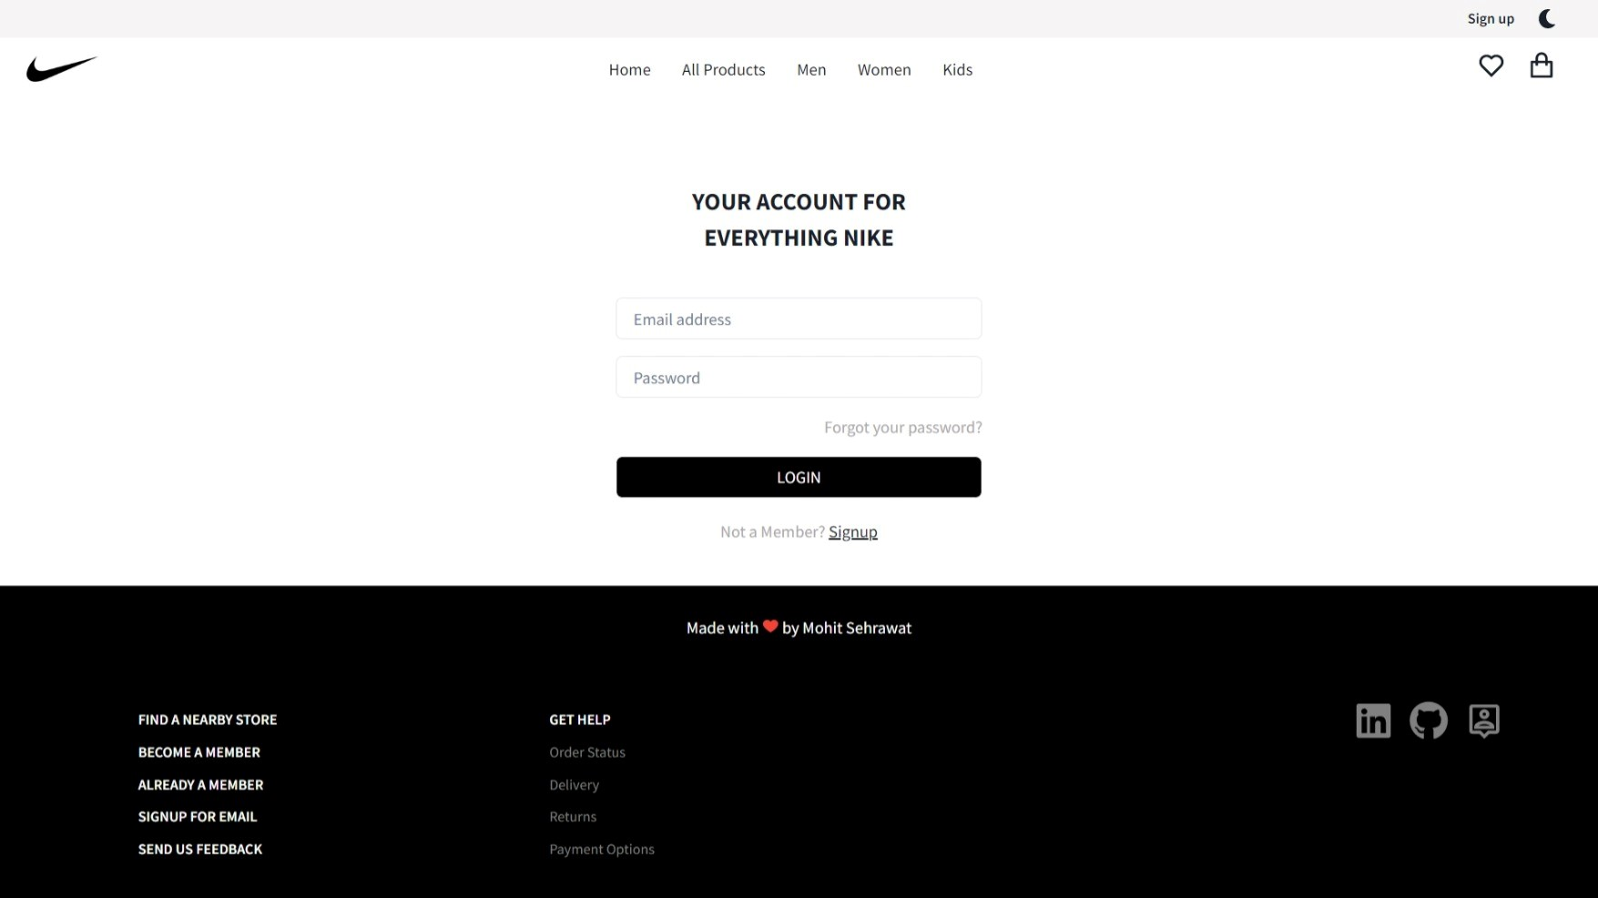

Slide 19
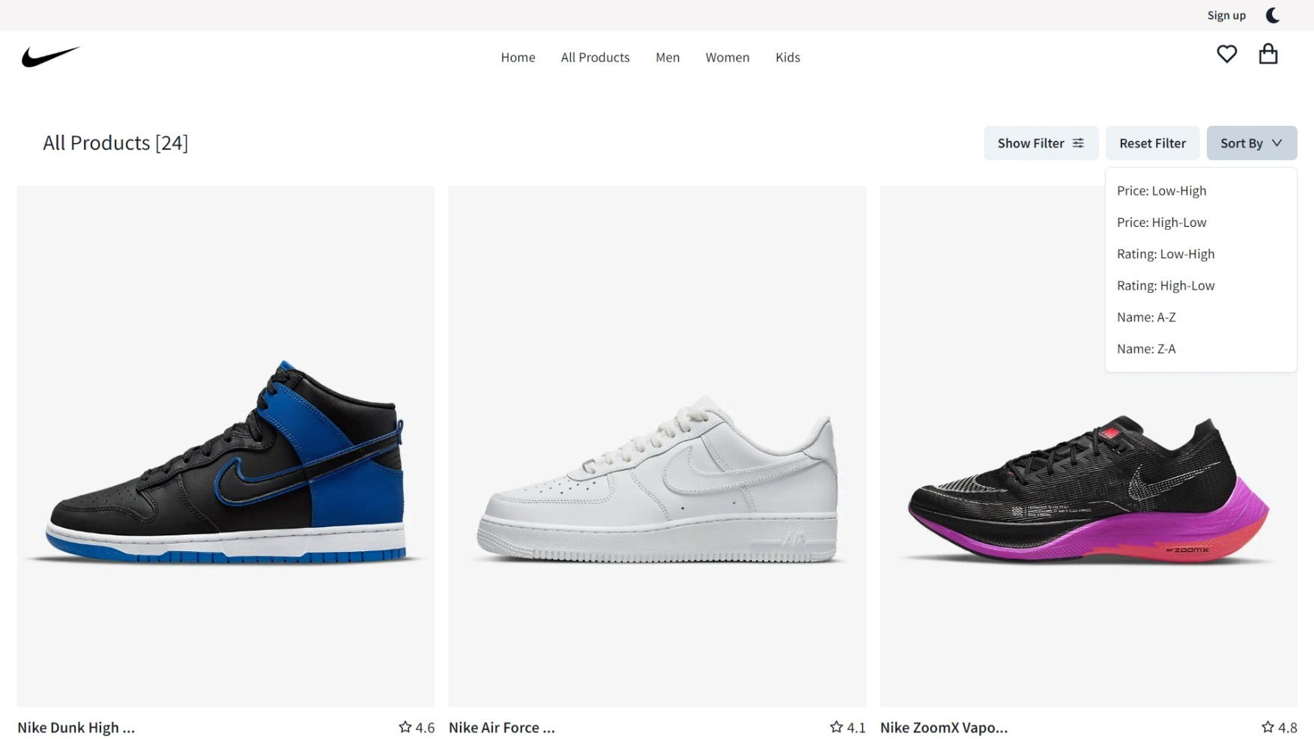

Slide 20
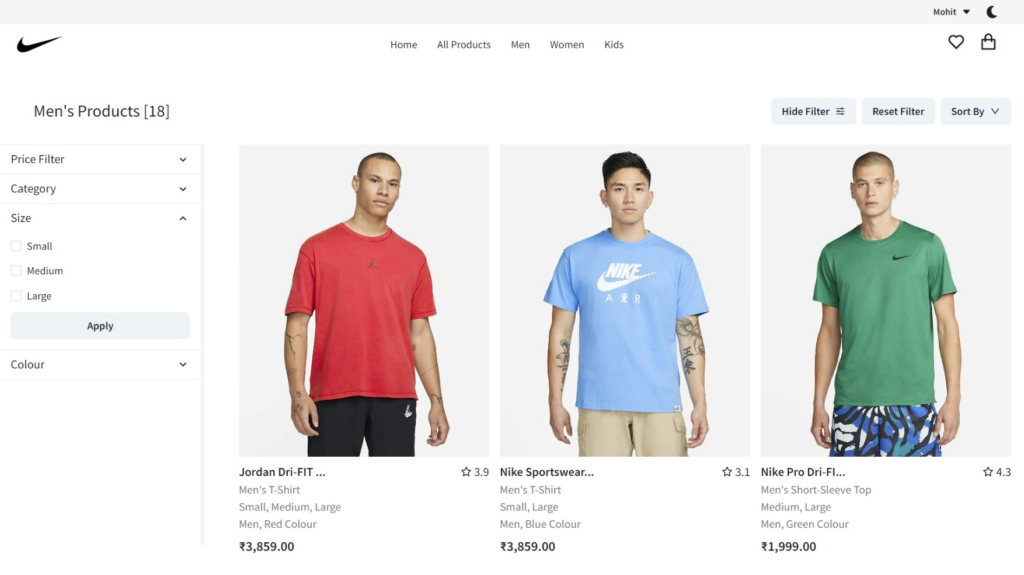

Slide 21
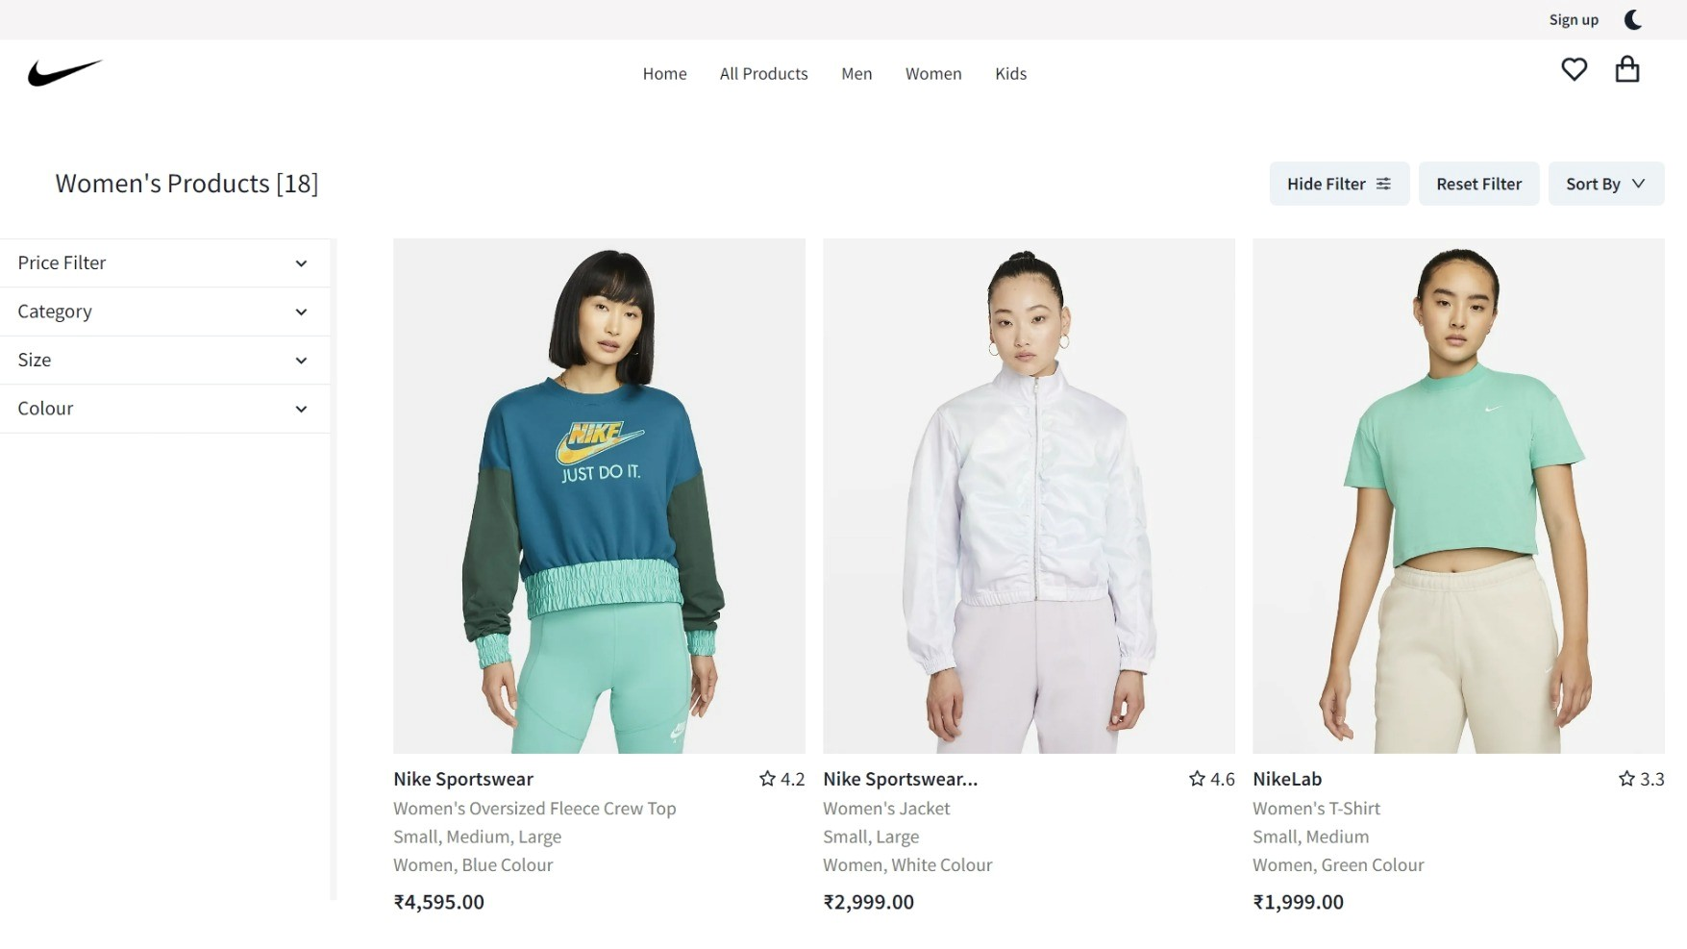

Slide 22
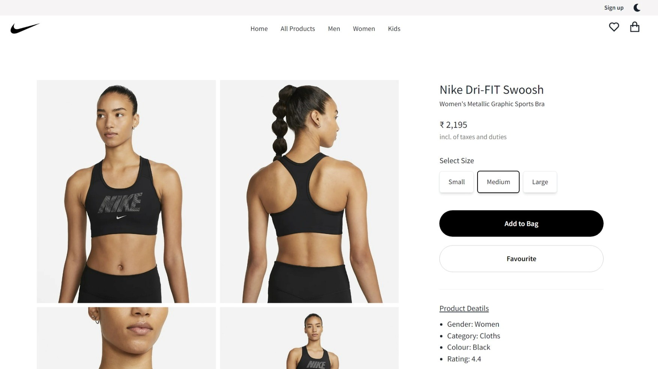

Slide 23
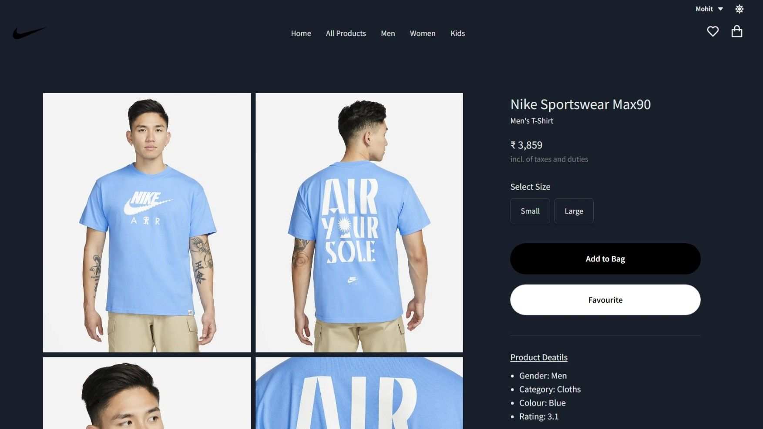

Slide 24
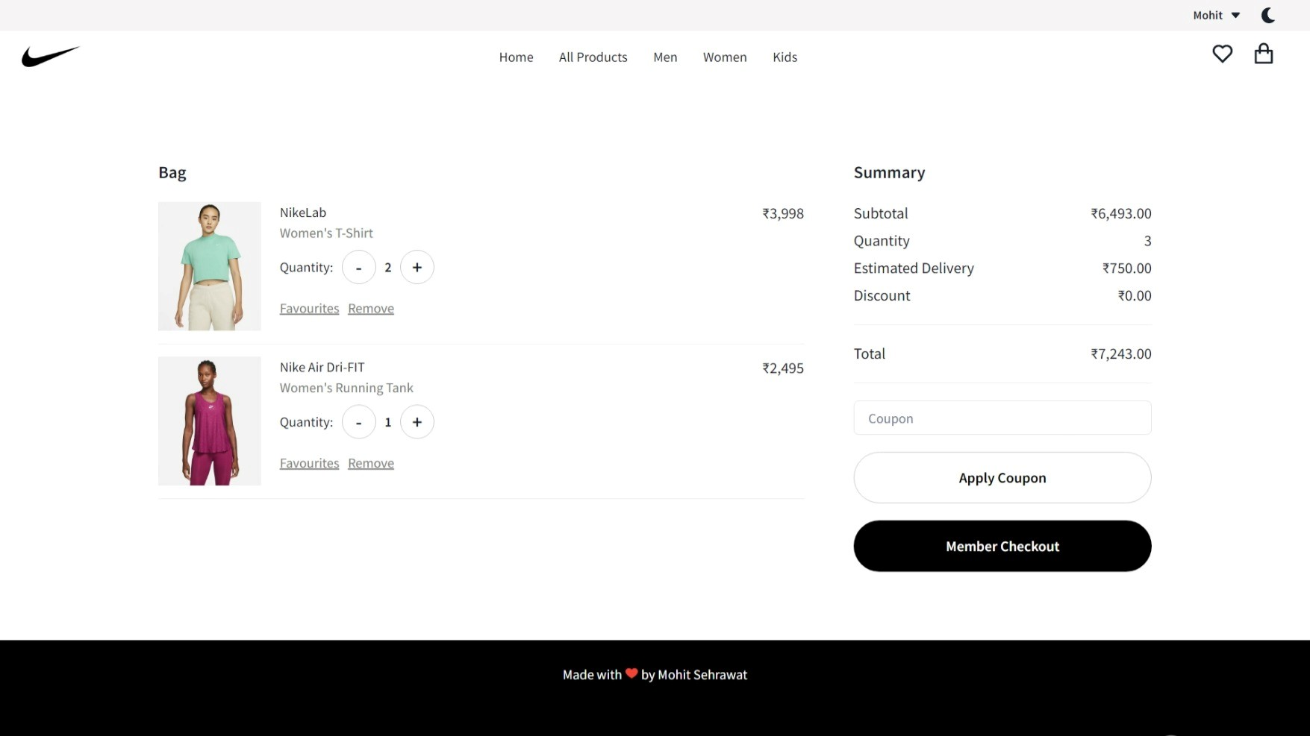

Slide 25
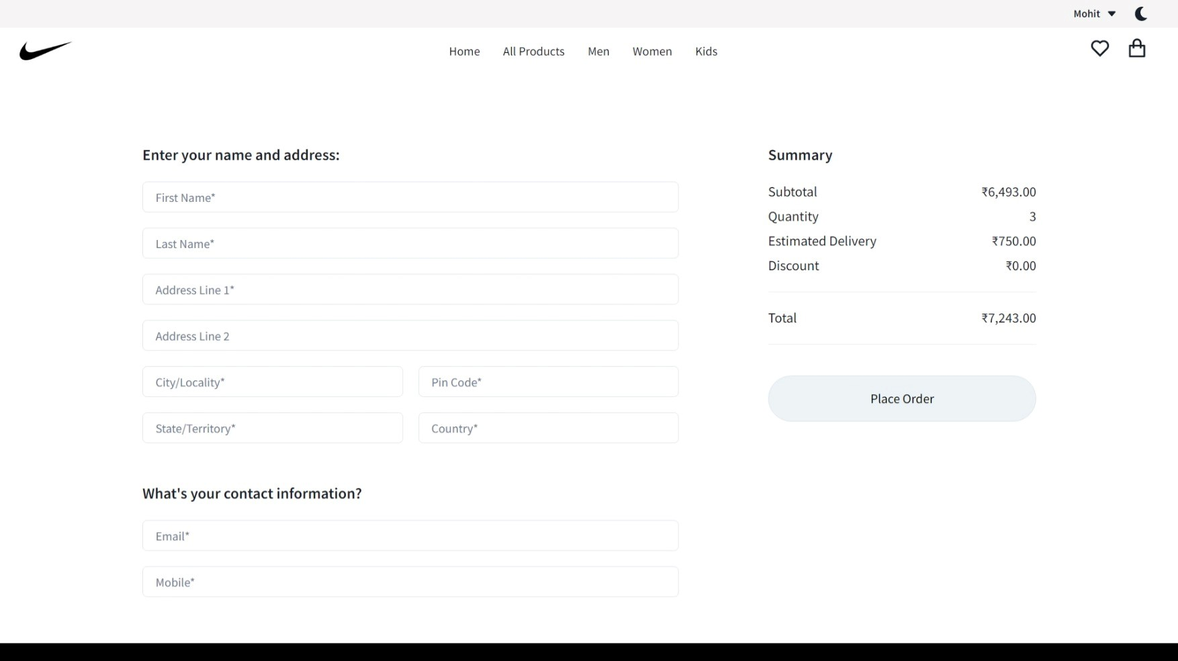

Slide 26
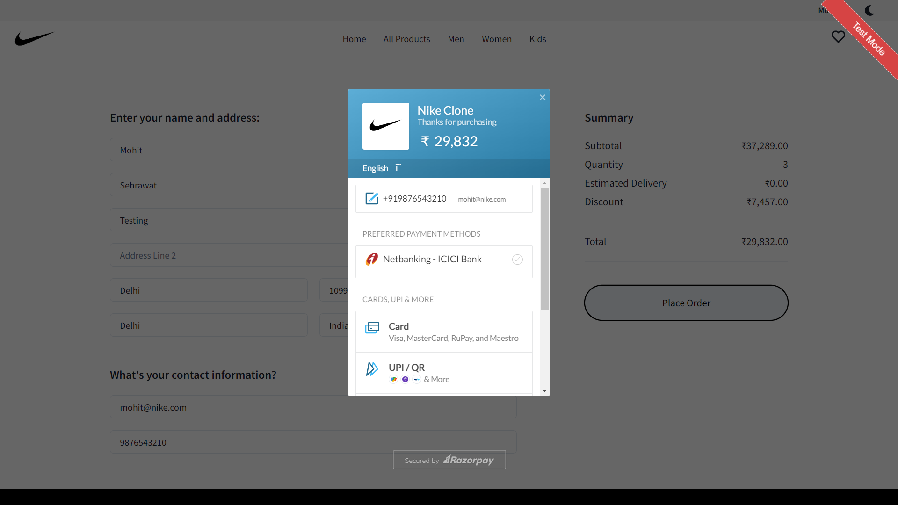

Slide 27
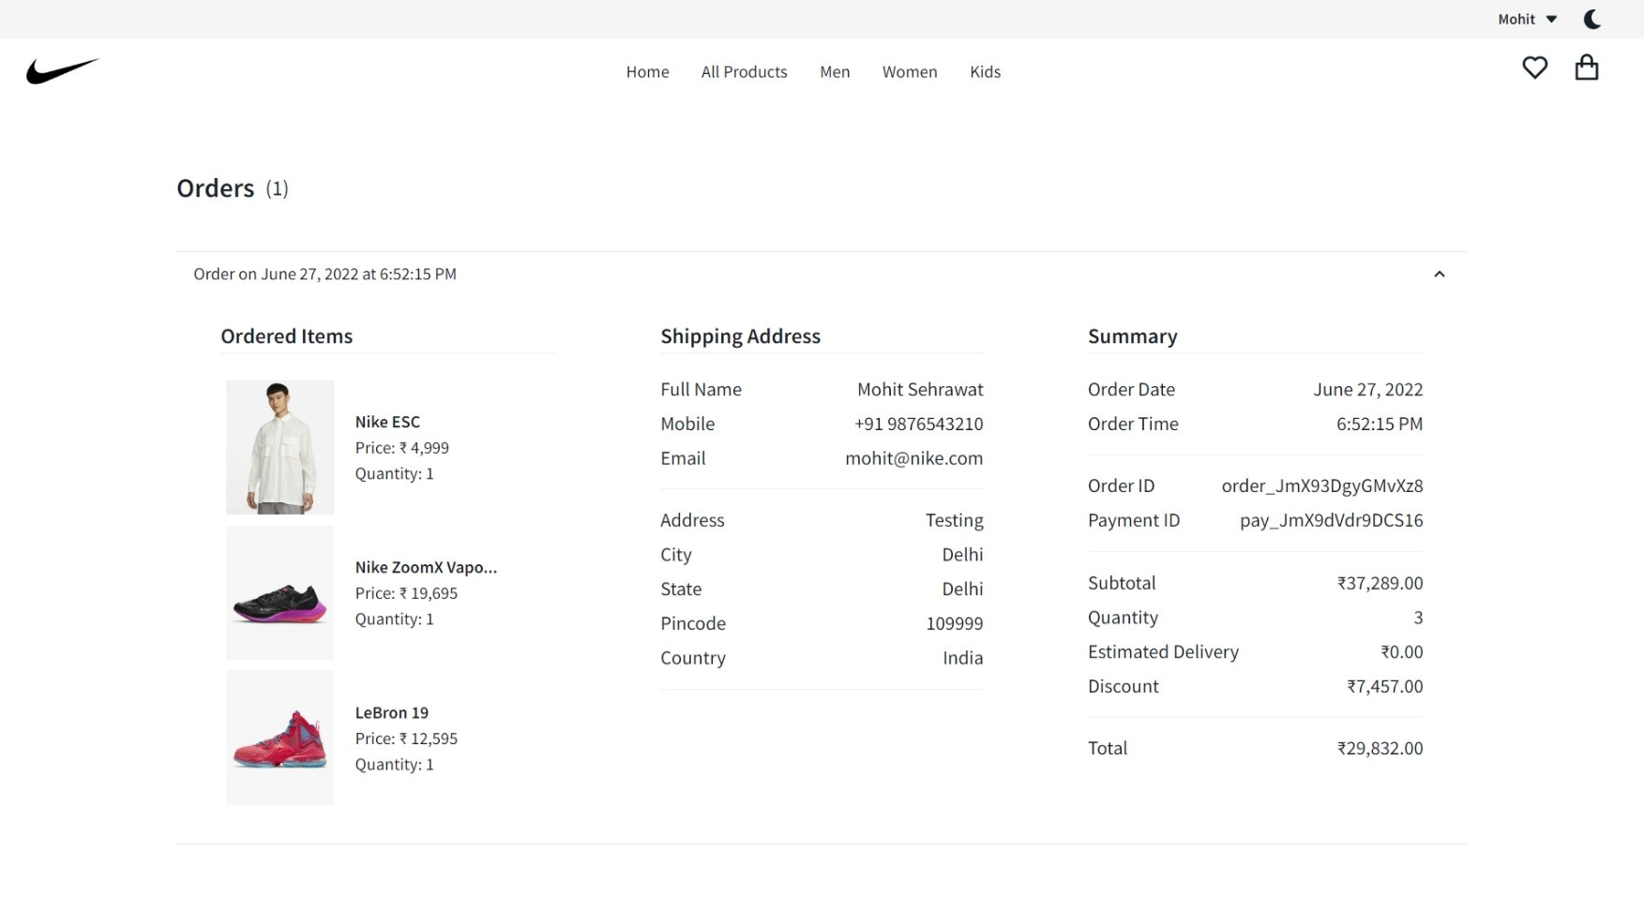

Slide 28
Conclusion & Future
Faster buying process.
Store and product listing creation.
Cost reduction.
Affordable advertising and marketing.
Flexibility for customers.
No reach limitations.
Product and price comparison.
Faster response to buyer/market demands
Creating a website of this huge scale was an Amazing experience.
I am looking forward to making following Enhansments In my project:-
1.Better UI
2.Order Tracking System
3.Trend and News Section
4.Buying guide for unfamiliar products

